Slide 1
BCSE103E- Computer Programming: JAVA
Dr. S. A. AMUTHA JEEVAKUMARI
Assistant Professor (Sr.)
School of Computer Science and Engineering
VIT - Chennai

Slide 2
Inheritance
Inheritance
Multi level inheritance
Polymorphism
Overriding

Slide 3

Java Inheritance
Inheritance can be defined as the process where one class acquires the properties (methods and fields) of another.
It is an important part of OOPs (Object Oriented programming system). The class which inherits the properties of other is known as subclass
(derived class, child class).
The class whose properties are inherited is known as superclass (base class, parent class).
Inheritance represents the IS-A relationship which is also known as a Parent-Child relationship.
The idea behind inheritance is to create new(Child/Sub) classes that are built upon existing(Parent/Super) classes. By Inheriting, can reuse methods and fields of the Parent class. Moreover, you can add new methods and fields in your current class also.
CSE1007-Java Programming

Slide 4
extends keyword
extends is the keyword used to inherit the properties of a class.
Syntax :
class Super { // Parent/Base Class
.....
.....
}
Inheritance
class Sub extends Super {
.....
.....
}
// Child/Derivered Class
Note
A subclass inherits all the members (fields, methods, and nested classes) from its superclass. Constructors are not members, so they are not inherited by subclasses, but the constructor of the superclass can be invoked from the subclass.
CSE1007-Java Programming

Slide 5
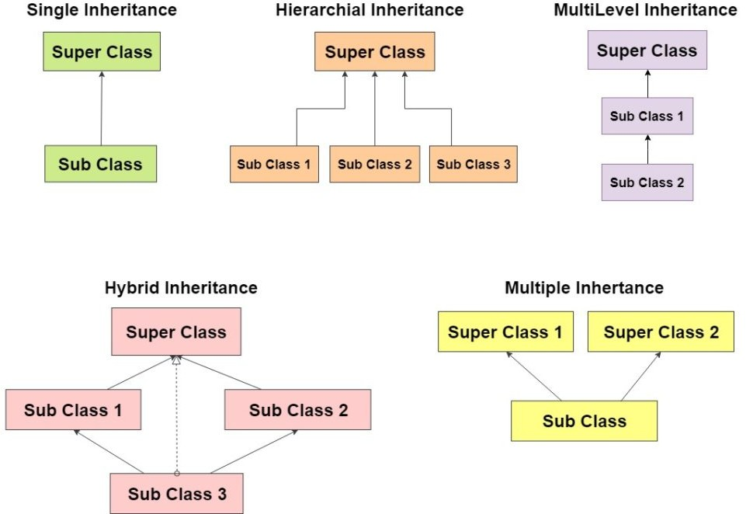
Types of Inheritance
CSE1007-Java Programming

Slide 6
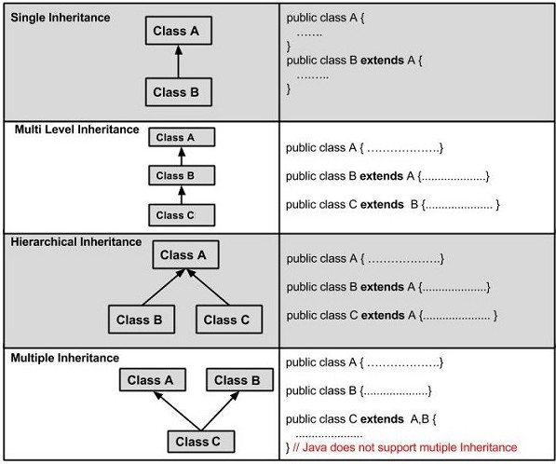
Types of Inheritance
CSE1007-Java Programming

Slide 7
Example-1 : Single Inheritance
class Animal{ void eat() {
}
System.out.println("eating..."); }
class Dog extends Animal{
void bark() { System.out.println("barking..."); }
}
class SingletInheritance
{
public static void main(String args[])
{
Dog d=new Dog(); d.bark();
d.eat();
}
}
/* barking...
* eating... */
CSE1007-Java Programming

Slide 8
Example-1 : Single Inheritance
class Animal{ void eat() {
}
System.out.println("eating..."); }
class Dog extends Animal{
void bark() { System.out.println("barking..."); }
}
class SingletInheritance
{
public static void main(String args[])
{
Dog d=new Dog(); d.bark();
d.eat();
}
}
/* barking...
* eating... */
CSE1007-Java Programming

Slide 9
Example-2 : Multilevel Inheritance
class Animal { void eat() {
}
System.out.println("eating..."); }
class Dog extends Animal {
void bark() { System.out.println("barking..."); }
}
class BabyDog extends Dog {
void weep() { System.out.println("weeping..."); }
}
class MultilevelInheritance {
public static void main(String args[]) { BabyDog d = new BabyDog();
d.weep(); d.bark(); d.eat();
}
}
/* weeping...
barking...
eating... */
CSE1007-Java Programming

Slide 10
Example-3 : Hierarchical Inheritance
class Animal{
void eat(){System.out.println("eating...");}
}
class Dog extends Animal{
void bark(){System.out.println("barking...");}
}
class Cat extends Animal{
void meow(){System.out.println("meowing...");}
}
class HierarchicalInheritance{
public static void main(String args[]){ Cat c=new Cat();
c.meow(); c.eat();
//c.bark(); //C.T.Error (Not permitted to access)
}
}
/* meowing...
* eating...
*/
CSE1007-Java Programming

Slide 11
Multiple Inheritance
Why multiple inheritance is not supported in java?
To reduce the complexity and simplify the language, Multiple inheritance is not supported in java.
Example : Consider a scenario where A, B, and C are three classes. The C class inherits A and B classes. If A and B classes have the same method and you call it from child class object, there will be ambiguity to call the method of A or B class.
Since Compile-time errors are better than Runtime errors, ava renders compile-time error if you inherit 2 classes. So whether you have same method or different, there will be compile time error.
CSE1007-Java Programming

Slide 12
Example-4 : Mulitple Inheritance
class A{
void msg(){System.out.println("Hello");}
}
class B{
void msg(){System.out.println("Welcome");}
}
class C extends A,B{ //suppose if it were
public static void main(String args[]){ C obj=new C();
obj.msg(); //Now which msg() method would be invoked?
}
}
// Compile Time Error
CSE1007-Java Programming

Slide 13
Example-1 : Inheritance
class Employee{
float salary=40000;
}
class Programmer extends Employee{ int bonus=10000;
public static void main(String args[]){ Programmer p=new Programmer();
System.out.println("Programmer salary is:"+p.salary); System.out.println("Bonus of Programmer is:"+p.bonus);
}
}
/* Programmer salary is:40000.0
* Bonus of programmer is:10000 */
CSE1007-Java Programming

Slide 14
Example-2 : Inheritance
class Vehicle {
protected String brand = "Ford"; public void honk() {
System.out.println("Tuut, tuut!");
}
}
class Car extends Vehicle {
// Vehicle attribute
// Vehicle method
private String modelName = "Mustang"; public static void main(String[] args) {
Car myCar = new Car(); myCar.honk();
// Car attribute
System.out.println(myCar.brand + " " + myCar.modelName);
}
}
/* Tuut, tuut!
* Ford Mustang */
CSE1007-Java Programming

Slide 15
Example-3 : Inheritance
class Calculation { int z;
public void addition(int x, int y) {
z = x + y;
System.out.println("The sum :"+z);
}
public void Subtraction(int x, int y) { z = x - y;
System.out.println("The difference :"+z);
}
}
public class My_Calculation extends Calculation { public void multiplication(int x, int y) {
z = x * y;
System.out.println("The product o:"+z);
}
public static void main(String args[]) { int a = 20, b = 10;
My_Calculation C = new My_Calculation();
C.addition(a, b); C.Subtraction(a, b);
}
}
/* The sum :3 0
The difference :10
The product :200 */
C.multiplication(a, b);
CSE1007-Java Programming

Slide 16
Example-4 : Inheritance I
//Java program to illustrate the concept of inheritance
class Bicycle { // base class
public int gear, speed; // the Bicycle class has two fields
public Bicycle(int gear, int speed) { // Constructor
this.gear = gear; this.speed = speed;
}
public void applyBrake(int decrement) { speed -= decrement; } public void speedUp(int increment) { speed += increment; }
// toString() method to print info of Bicycle
public String toString() {
return("No of gears are "+gear +"\n"
+ "speed of bicycle is "+speed);
}
}
CSE1007-Java Programming

Slide 17
Example-4 : Inheritance II
class MountainBike extends Bicycle { // derived class
public int seatHeight; // MountainBicke class has one field
public MountainBike(int gear,int speed, int startHeight) { super(gear, speed); seatHeight = startHeight;
}
public void setHeight(int newValue) { seatHeight = newValue;
}
// overriding toString() method of Bicycle to print more info
@Override
public String toString() {
return (super.toString()+ "\nseat height is "+seatHeight);
}
}
CSE1007-Java Programming

Slide 18
Java Polymorphism
It is an important concept of object-oriented programming. It simply means more than one form.
It as the ability of a message to be displayed in more than one form. It is the ability of an object to take on many forms.
Polymorphism in Java is a concept by which we can perform a single action in different ways.
It is derived from 2 Greek words: poly and morphs.
The word "poly" means many and "morphs" means forms. So polymorphism means many forms.
There are two types of polymorphism in Java: Compile-Time polymorphism - Static (Example : Method/Operator Overloading)
But, Java doesn’t support Operator Overloading.
Runtime polymorphism - Dynamic
(Example : Method Overriding)
CSE1007-Java Programming

Slide 19
Method Overloading
When there are multiple functions with same name but different parameters then these functions are said to be overloaded.
Functions can be overloaded by change in number of arguments or/and
change in type of arguments.
Why Method Overloading ?
Suppose, a task to perform the addition of given numbers but there can be any number of arguments (let’s say either 2 or 3 arguments for simplicity).
In order to accomplish the task, can create two methods sum2num(int, int) and sum3num(int, int, int) for two and three parameters respectively.
However, other programmers, as well as you in the future may get confused
as the behavior of both methods are the same but they differ by name.
The better way to accomplish this task is by overloading methods. And, depending upon the argument passed, one of the overloaded methods is called. This helps to increase the readability of the program.
CSE1007-Java Programming

Slide 20
Method Overloading
Important Points to remember :
Two or more methods can have same name inside the same class if they accept different arguments. This feature is known as method overloading.
Method overloading is achieved by either:
Changing the number of arguments. Changing the datatype of arguments.
Method overloading is not possible by changing the return type of methods.
CSE1007-Java Programming

Slide 21
Example : Method Overloading (Different types Arguments)
// Java program for Method overloading
class MultiplyFun {
// Method with 2 parameter
static int Multiply(int a, int b) {
return a * b; }
// Method with the same name but 2 double parameter
static double Multiply(double a, double b) { return a * b; }
}
class MehtodOverloading {
public static void main(String[] args) {
System.out.println(MultiplyFun.Multiply(2, 4));
System.out.println(MultiplyFun.Multiply(5.5, 6.3));
}
}
/* 8
* 34.65 */
CSE1007-Java Programming

Slide 22
Example : Method Overloading (Different No. of Arguments)
// Java program for Method overloading
class MultiplyFun {
// Method with 2 parameter
static int Multiply(int a, int b) {
}
return a * b; }
// Method with the same name but 3 parameter
static int Multiply(int a, int b, int c) { return a * b * c; }
}
class Main {
public static void main(String[] args) { System.out.println(MultiplyFun.Multiply(2, 4));
System.out.println(MultiplyFun.Multiply(2, 7, 3));
}
}
/* 8
* 42 */
CSE1007-Java Programming

Slide 23
Example : Method Overloading (Only with 1 Argument)
class HelperService {
private String formatNumber(int value) { return String.format("%d", value);
}
private String formatNumber(double value) { return String.format("%.3f", value);
}
private String formatNumber(String value) {
return String.format("%.2f", Double.parseDouble(value));
}
public static void main(String[] args) { HelperService hs = new HelperService(); System.out.println(hs.formatNumber(500)); System.out.println(hs.formatNumber(89.9934)); System.out.println(hs.formatNumber("550"));
}
}
/* 500
* 89.993
* 550.00 */
CSE1007-Java Programming

Slide 24
Method Overriding
It is also known as Dynamic Method Dispatch.
It is a process in which a function call to the overridden method is resolved at Runtime and can be achieved by Method Overriding.
It occurs when a derived class has a definition for one of the member functions of the base class. That base function is said to be overridden.
Rules :
Both the superclass and the subclass must have the same method name, the same return type and the same parameter list.
Can’t override the method declared as final and static. Always override abstract methods of the superclass
Can we access the method of the superclass after overriding? (Yes, using super keyword)
CSE1007-Java Programming

Slide 25
Example-1 : Method Overriding
class Animal {
public void displayInfo() { System.out.println("I am an animal.");
}
}
class Dog extends Animal {
@Override // Not Compulsory (Tells explicitly to Compiler)
public void displayInfo() { System.out.println("I am a dog.");
}
}
class MethodOverriding {
public static void main(String[] args) { Dog d1 = new Dog();
d1.displayInfo();
}
}
//
I am a dog.
Dr. Nachiyappan S
CSE1007-Java Programming

Slide 26
Example-2 : Method Overriding(using super)
class Animal {
public void displayInfo() { System.out.println("I am an animal.");
}
}
class Dog extends Animal { public void displayInfo() {
super.displayInfo(); // Invoking Base Class Method
System.out.println("I am a dog.");
}
}
class MethodOverriding {
public static void main(String[] args) { Dog d1 = new Dog();
d1.displayInfo();
}
}
// I am an animal.
//
I am a dog.
Dr. Nachiyappan S
CSE1007-Java Programming

Slide 27
Example-3 : Method Overriding
class Vehicle{ void run(){
System.out.println("Vehicle is running");
}
}
//Creating a child class
class Bike extends Vehicle{
public static void main(String args[]){
//creating an instance of child class
Bike obj = new Bike();
//calling the method with child class instance
obj.run();
}
}
// Vehicle is running
CSE1007-Java Programming

Slide 28
Example-4 : Method Overriding
//To illustrate the use of Java Method Overriding
//creating a parent class.
class Vehicle{
//defining a method
void run(){ System.out.println("Vehicle is running"); }
}
class Bike extends Vehicle{ //Creating a child class
//defining the same method as in the parent class
void run(){ System.out.println("Bike is running safely"); }
public static void main(String args[]){
Bike obj = new Bike(); obj.run();
//creating object
//calling method
}
}
// Bike is running safely
CSE1007-Java Programming

Slide 29
Example-5 : Method Overriding
//Program to demonstrate the real scenario of Java Method Overriding
class Bank{ int getRateOfInterest(){return 0;} }
//Creating child classes.
class SBI extends Bank { int getRateOfInterest(){return 8;} } class ICICI extends Bank{ int getRateOfInterest(){return 7;} } class AXIS extends Bank { int getRateOfInterest(){return 9;} }
//MethodOVeridding class to create objects and call the methods
class MethodOveridding{
public static void main(String args[]){ SBI s=new SBI();
ICICI i=new ICICI();
AXIS a=new AXIS();
System.out.println("SBI Rate of Interest: "+s.getRateOfInterest()); System.out.println("ICICI Rate of Interest: "+i.getRateOfInterest()); System.out.println("AXIS Rate of Interest: "+a.getRateOfInterest());
}
Output:
SBI Rate of Interest: 8 ICICI Rate of Interest: 7 AXIS Rate of Interest: 9
}
CSE1007-Java Programming

Slide 30
Pointer to Remember for Method Overriding
Can we override static method?
No, a static method cannot be overridden. It can be proved by runtime polymorphism
Why can we not override static method?
It is because the static method is bound with class whereas instance method is bound with an object. Static belongs to the class area, and an instance belongs to the heap area.
Can we override java main method?
No, because the main is a static method.
CSE1007-Java Programming

Slide 31
Method Overloading Vs Method Overriding
Differences between Method Overloading and Method Overriding
No. | Method Overloading | Method Overriding
1) | It is used to increase the readability of the program. | It is used to provide the specific implementation of the method i.e., already provided by its super class.
2) | It is performed within class. | It occurs in two classes that have IS-A (inheritance) relationship.
3) | In case of method overloading, parameter must be different. | In case of method overriding, parameter must be same.
4) | Compile time polymorphism. | Run time polymorphism.
5) | It can’t be performed by changing return type of the method only. Return type can be same or different in method overloading. But must have to change the parameter. | Return type must be same or covariant in method overriding.
CSE1007-Java Programming

Slide 32
ABSTRACT CLASS
INTERFACES

Slide 33
Java Abstraction
It is the quality of dealing with ideas rather than events.
For Example : Consider E-mail, complex details such as what happens as soon as you send an e-mail, the protocol your e-mail server uses are hidden from the user.
Therefore, to send an e-mail, just need to type the content, mention the
address of the receiver, and click send.
In OOP : Abstraction is a process of hiding the implementation details from the user, only the functionality will be provided to the user.
In other words, User will have the information on what the object does instead of how it does it.
In Java, Abstraction is achieved using Abstract classes and Interfaces.

Slide 34
Abstract Class
A class which contains the abstract keyword in its declaration is known as
Abstract class.
Abstract classes may or may not contain abstract methods, i.e., methods without body ( public void get(); )
But, if a class has at least one abstract method, then the class must be declared abstract.
If a class is declared abstract, it cannot be instantiated (creating an Object).
To use an abstract class, you have to inherit it from another class, provide implementations to the abstract methods in it.
If you inherit an abstract class, you have to provide implementations to all the abstract methods in it.
The abstract keyword is a non-access modifier, used for classes and methods
CSE1007-Java Programming

Slide 35
Example-1: Abstract Class I
/* File name : Employee.java */
public abstract class Employee { private String name, address; private int number;
public Employee(String name, String address, int number) { System.out.println("Constructing an Employee"); this.name = name; this.address = address; this.number = number;
}
public double computePay() { System.out.println("Inside Employee computePay"); return 0.0;
}
public void mailCheck() { System.out.println("Mailing a check to " +
this.name + " " + this.address);
}
public String toString() {
return name + " " + address + " " + number;
}
CSE1007-Java Programming

Slide 36
Example-1: Abstract Class II
public String getName() { return name; }
public String getAddress() { return address; }
public void setAddress(String newAddress) { address = newAddress; } public int getNumber() { return number; }
}
/* File name : AbstractDemo.java */
public class AbstractDemo {
public static void main(String [] args) {
/* Following is not allowed and would raise error */
Employee e = new Employee("Pradeep K V.", "Vandalur - Chennai", 50); System.out.println("\n Call mailCheck using Employee reference--"); e.mailCheck();
}
}
/* Exception in thread "main" java.lang.Error: Unresolved
* compilation problem: Cannot instantiate the type Employee */
CSE1007-Java Programming

Slide 37
Example-2: Abstract Class and Methods
// Abstract class
abstract class Animal {
// Abstract method (does not have a body)
public abstract void animalSound();
// Regular method
public void sleep() { System.out.println("Zzz");
}
}
// Subclass (inherit from Animal)
class Pig extends Animal { public void animalSound() {
// The body of animalSound() is provided here
System.out.println("The pig says: wee wee");
}
}
class Main {
public static void main(String[] args) {
Pig myPig = new Pig(); myPig.animalSound(); myPig.sleep();
// Create a Pig object
}
}
CSE1007-Java Programming

Slide 38
Example-3: Abstract Class and Methods I
abstract class EMPLOYEE { private String Name; private int Number;
public EMPLOYEE(String name, int number) { System.out.println("Constructing an Employee"); this.Name = name;
this.Number = number;
}
public String getName() { return Name;
}
// Remainder of class definition
public abstract double computePay();
}
class SAL extends EMPLOYEE {
private double salary; // Annual salary
public SAL(String name, int number, double newsalary) { super(name, number);
salary = newsalary;
}
CSE1007-Java Programming

Slide 39
Example-3: Abstract Class and Methods II
public double computePay() {
System.out.print("The Salary for " + getName() + " is : " ); return salary+2000;
}
}
class Emp{
public static void main(String[] args){
SAL e = new SAL("Pradeep K V", 3, 2000.0);
System.out.println(e.computePay());
}
}
/* Constructing an Employee
* The Salary for Pradeep K V is : 4000.0 */
CSE1007-Java Programming

Slide 40
Java Interfaces
Another way to achieve abstraction in Java, is with interfaces.
An interface is a completely "abstract class" that is used to group related methods with empty bodies
An interface is a reference type. It is similar to class. It is a collection of abstract methods.
A class implements an interface, thereby inheriting the abstract methods of the interface.
It is similar to writing a class. But a class describes the attributes and behaviors of an object. And an interface contains behaviors that a class implements.
// interface
interface Animal {
public void animalSound(); // interface method (does not have a body)
public void run(); // interface method (does not have a body)
}
CSE1007-Java Programming

Slide 41
Interfaces....!
An interface is similar to a class in the following ways : An interface can contain any number of methods.
An interface is written in a file with a .java extension, with the name of the interface matching the name of the file.
The byte code of an interface appears in a .class file.
Interfaces appear in packages, and their corresponding bytecode file must be in a directory structure that matches the package name.
However, an interface is different from a class in several ways, including : You cannot instantiate an interface.
It does not contain any constructors and the methods in an interface are
abstract.
It cannot contain instance fields. The only fields that can appear in an interface must be declared both static and final.
It is not extended by a class; it is implemented by a class. It can extend multiple interfaces.
CSE1007-Java Programming

Slide 42
Exampe-1 : Java Interface
interface FirstInterface {
public void myMethod(); // interface method
}
interface SecondInterface {
public void myOtherMethod(); // interface method
}
class DemoClass implements FirstInterface, SecondInterface { public void myMethod() {
System.out.println("myMethod() from First Interface");
}
}
public void myOtherMethod() {
System.out.println("myOtherMethod from Second Interface");
}
}
public class Interface_Demo {
public static void main(String[] args) { DemoClass myObj = new DemoClass(); myObj.myMethod(); myObj.myOtherMethod();
}
}
// myMethod() from First Interface
// myOtherMethod from Second Interface
CSE1007-Java Programming

Slide 43
Exampe-2 : Java Interface
// Interface
interface Animals {
public void animalSound(); // interface method (does not have a body)
public void sleep(); // interface method (does not have a body)
}
class Cat implements Animals {
public void animalSound() { System.out.println("The Cat makes meow meow public void sleep() { System.out.println("Zzz"); }
}
class Dog implements Animals {
public void animalSound() { System.out.println("The Dog makes bow bow"); public void sleep() { System.out.println("Zzz"); }
}
class Interface_Animal{
public static void main(String[] args) {
Cat c = new Cat(); c.animalSound(); Dog d = new Dog(); d.animalSound();
}
}
// The Cat makes meow meow
// The Dog makes bow bow
CSE1007-Java Programming

Slide 44
Exampe-3 : Java Interface
interface Language {
void getName(String name);
}
class ProgrammingLanguage implements Language { public void getName(String name) {
System.out.println("Programming Language: " + name);
}
}
public class Interface_Language {
public static void main(String[] args) {
ProgrammingLanguage language = new ProgrammingLanguage(); language.getName("Object Oriented Programming using JavA");
}
}
// Programming Language: Object Oriented Programming using JavA
CSE1007-Java Programming

Slide 45
Exampe-4 : Java Interface
interface Polygon { void getArea(int length, int breadth); }
class Rectangle implements Polygon {
public void getArea(int length, int breadth) {
System.out.println("The area of the rectangle is " + (length * breadth));
}
}
class Square implements Polygon {
public void getArea(int s1, int s2 ) {
System.out.println("The area of the square is " + (s1 * s2));
}
}
public class Interface_Figures {
public static void main(String[] args) {
// create an object
Rectangle r1 = new Rectangle(); r1.getArea(5, 6);
Square s1 = new Square(); s1.getArea(4,4);
}
}
// The area of the rectangle is 30
// The area of the square is 16
CSE1007-Java Programming

